Slide 1
Data Visualisation with R

Slide 2
Data manipulation
loading data
selecting columns
filtering
creating new columns
wide vs long data
Notes for me for what to cover. Will be removed

Slide 3
Data Visualisation
ggplot2
aesthetics
geoms
shapes and colours
themes
facets
Notes for me for what to cover. Will be removed

Slide 4
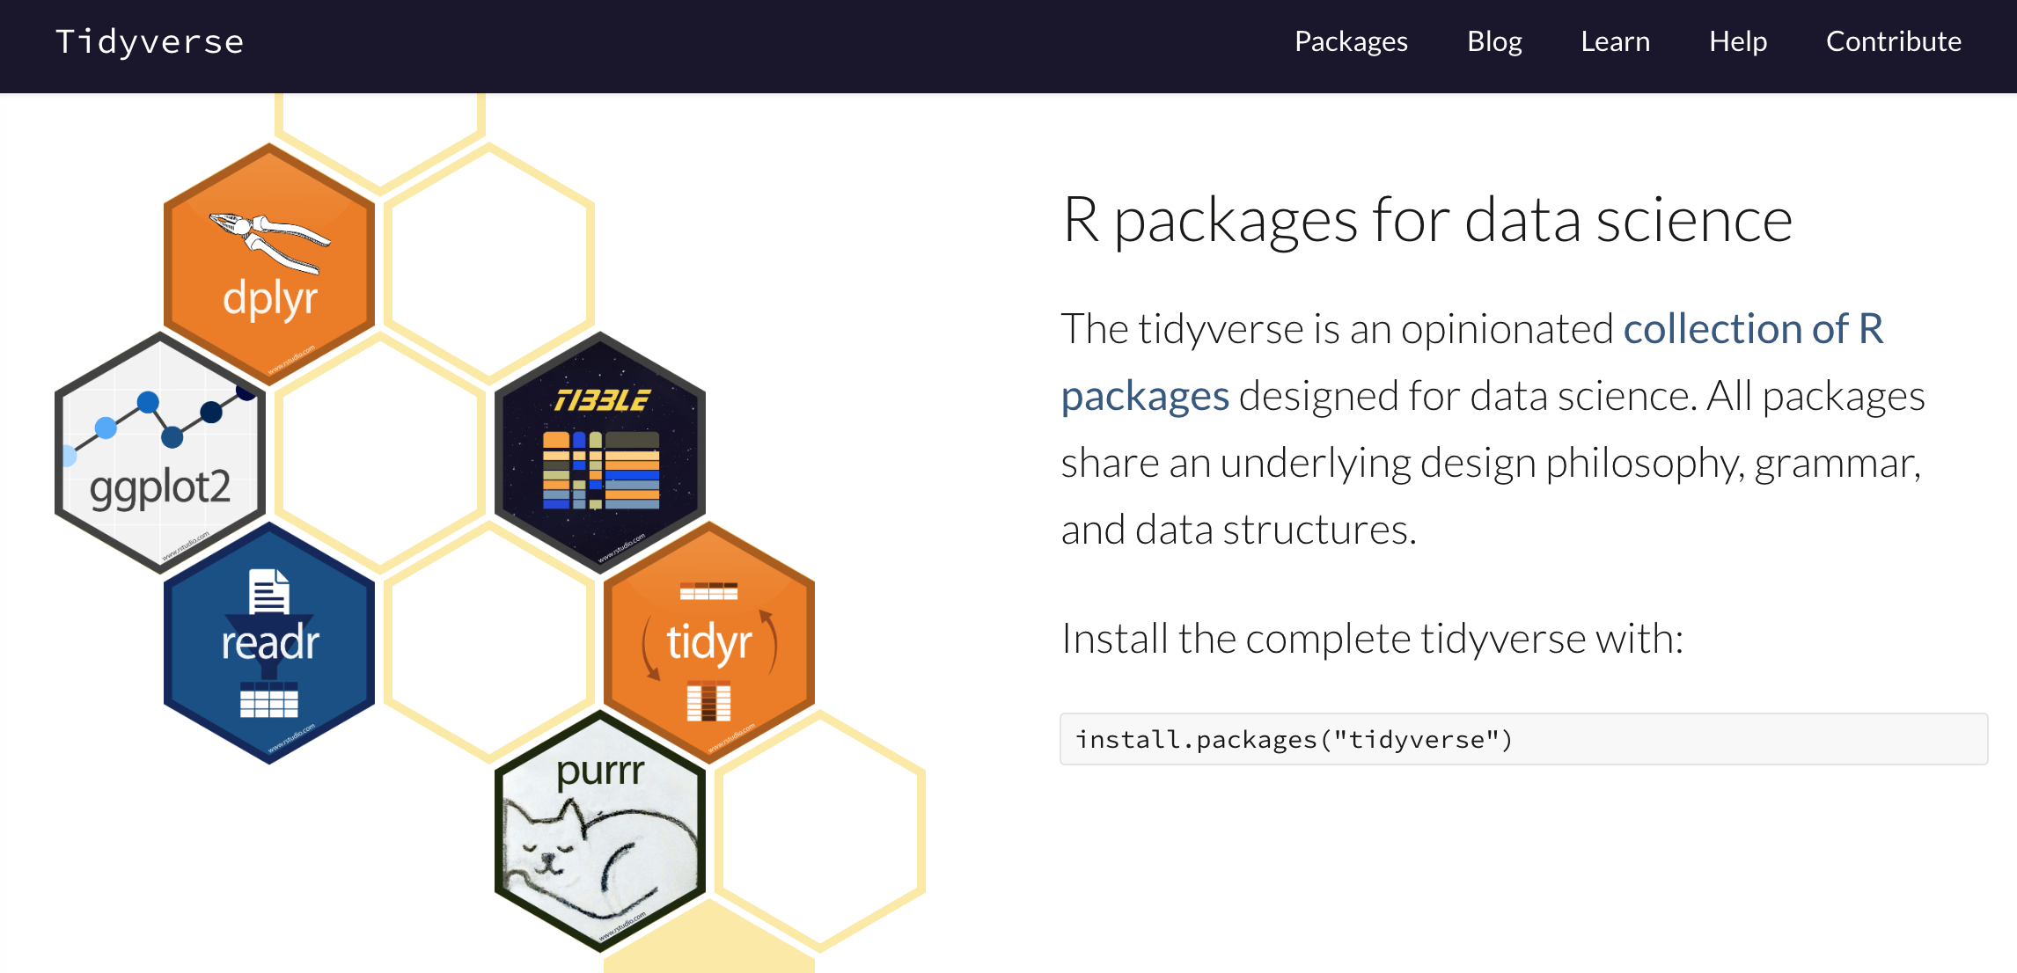
Tidyverse

Slide 5
Tidy data
Each variable forms a column
Each observation forms a row
Each type of observational unit forms a table
name | description | sample_1 | sample_2 | sample_3
slc35a5 | ENSDARG00000000001 | 36.28229146 | 33.4323 | 34.1081598
ccdc80 | ENSDARG00000000002 | 75.50639034 | 113.155 | 102.324479
nrf1 | ENSDARG00000000018 | 305.9479712 | 281.174 | 274.760176

Slide 6
Tidy data
Each variable forms a column
Each observation forms a row
Each type of observational unit forms a table
name | description | sample_1 | sample_2 | sample_3
slc35a5 | ENSDARG00000000001 | 36.28229146 | 33.4323 | 34.1081598
ccdc80 | ENSDARG00000000002 | 75.50639034 | 113.155 | 102.324479
nrf1 | ENSDARG00000000018 | 305.9479712 | 281.174 | 274.760176
name | description | sample | normalised_count
slc35a5 | ENSDARG00000000001 | sample_1 | 36.2823
ccdc80 | ENSDARG00000000002 | sample_1 | 75.5064
nrf1 | ENSDARG00000000018 | sample_1 | 305.948
slc35a5 | ENSDARG00000000001 | sample_2 | 33.4323
ccdc80 | ENSDARG00000000002 | sample_2 | 113.155
nrf1 | ENSDARG00000000018 | sample_2 | 281.174
slc35a5 | ENSDARG00000000001 | sample_3 | 34.1082
ccdc80 | ENSDARG00000000002 | sample_3 | 102.324
nrf1 | ENSDARG00000000018 | sample_3 | 274.76

Slide 7
Tidy data
Each variable forms a column
Each observation forms a row
Each type of observational unit forms a table
name | description | sample_1 | sample_2 | sample_3
slc35a5 | ENSDARG00000000001 | 36.28229146 | 33.4323 | 34.1081598
ccdc80 | ENSDARG00000000002 | 75.50639034 | 113.155 | 102.324479
nrf1 | ENSDARG00000000018 | 305.9479712 | 281.174 | 274.760176
name | description | sample | count | normalised_count
slc35a5 | ENSDARG00000000001 | sample_1 | 35 | 36.2823
ccdc80 | ENSDARG00000000002 | sample_1 | 75 | 75.5064
nrf1 | ENSDARG00000000018 | sample_1 | 300 | 305.948
slc35a5 | ENSDARG00000000001 | sample_2 | 30 | 33.4323
ccdc80 | ENSDARG00000000002 | sample_2 | 115 | 113.155
nrf1 | ENSDARG00000000018 | sample_2 | 283 | 281.174
slc35a5 | ENSDARG00000000001 | sample_3 | 31 | 34.1082
ccdc80 | ENSDARG00000000002 | sample_3 | 107 | 102.324
nrf1 | ENSDARG00000000018 | sample_3 | 276 | 274.76

Slide 8
Tidyverse

Slide 9
pipe
%>%
Equivalent of the Unix |
cut –f1,2,4 data.txt | head
select(data, c(1,2,4)) %>% head()
Allows sending the results of one function into the next
Makes code easier to read

Slide 10
%>%
from @dmi3k on Twitter

Slide 11

readr
read_tsv
reads in tab-delimited data and tries to guess the type of each column
character, integer etc.
read_csv
same for comma-separated files

Slide 12
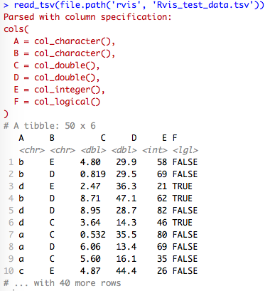

Slide 13
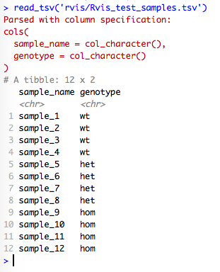
read_tsv

Slide 14
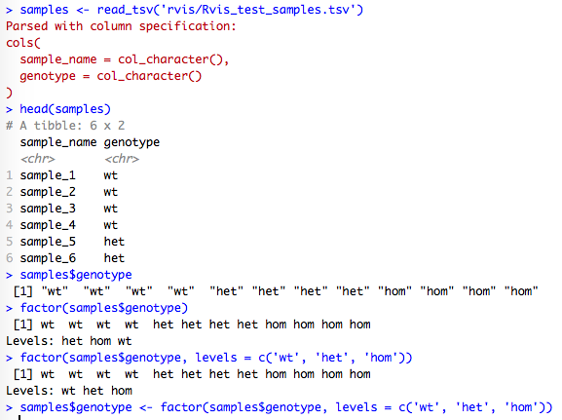
factors

Slide 15
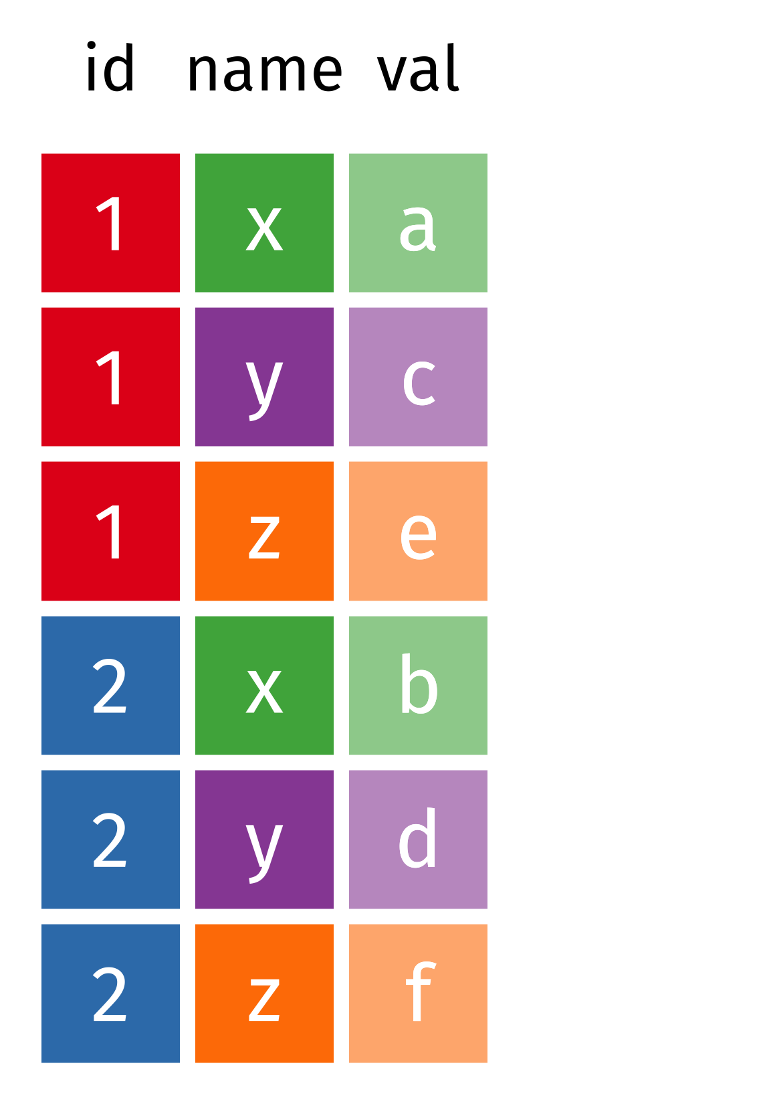
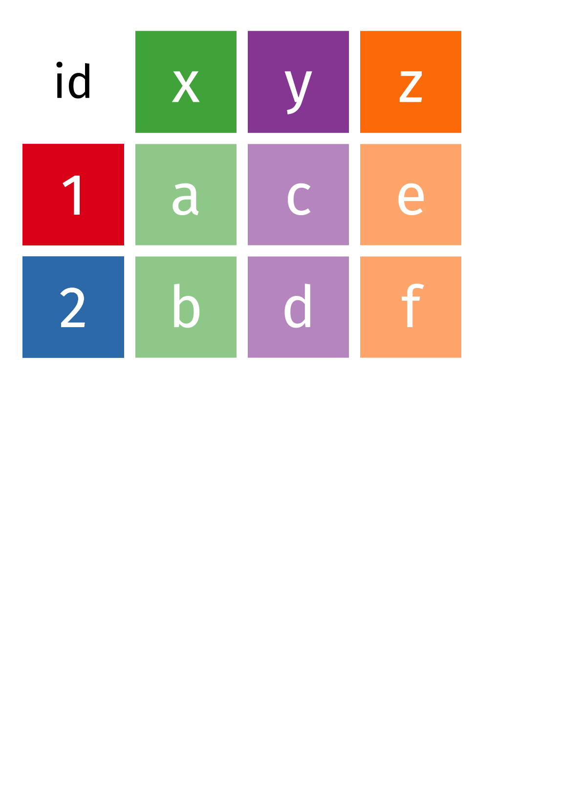
wide vs long data

Slide 16
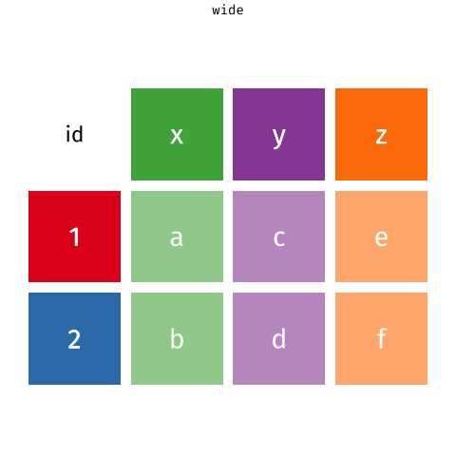
pivot_wider() and pivot_longer()

Slide 17
Tidy data
name | description | sample_1 | sample_2 | sample_3
slc35a5 | ENSDARG00000000001 | 36.28229146 | 33.4323 | 34.1081598
ccdc80 | ENSDARG00000000002 | 75.50639034 | 113.155 | 102.324479
nrf1 | ENSDARG00000000018 | 305.9479712 | 281.174 | 274.760176
name | description | sample | normalised_count
slc35a5 | ENSDARG00000000001 | sample_1 | 36.2823
ccdc80 | ENSDARG00000000002 | sample_1 | 75.5064
nrf1 | ENSDARG00000000018 | sample_1 | 305.948
slc35a5 | ENSDARG00000000001 | sample_2 | 33.4323
ccdc80 | ENSDARG00000000002 | sample_2 | 113.155
nrf1 | ENSDARG00000000018 | sample_2 | 281.174
slc35a5 | ENSDARG00000000001 | sample_3 | 34.1082
ccdc80 | ENSDARG00000000002 | sample_3 | 102.324
nrf1 | ENSDARG00000000018 | sample_3 | 274.76

Slide 18

Data manipulation
select(): pick variables
filter(): pick rows
mutate(): add new variables that are a function of existing ones
arrange(): sort rows
summarise()

Slide 19
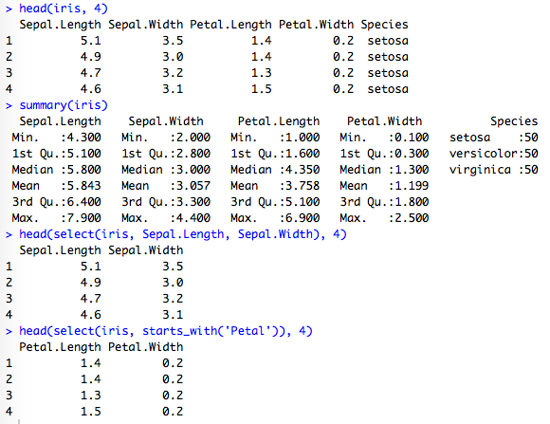
select()

Slide 20
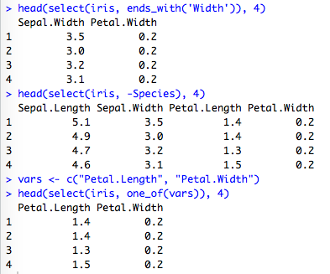
select()

Slide 21
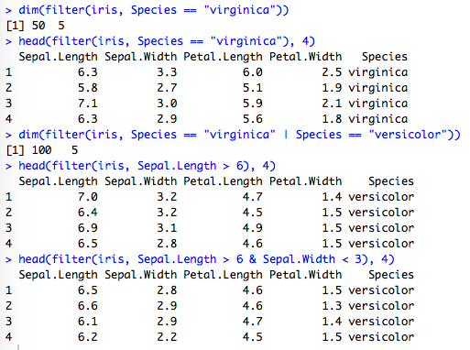
filter()

Slide 22
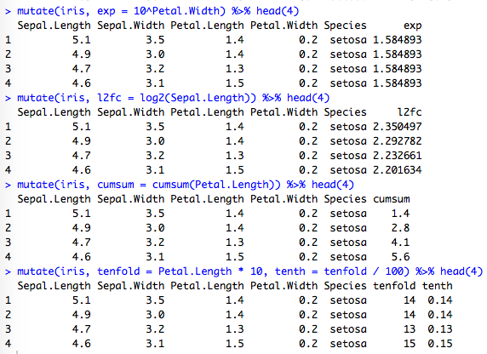
mutate()

Slide 23
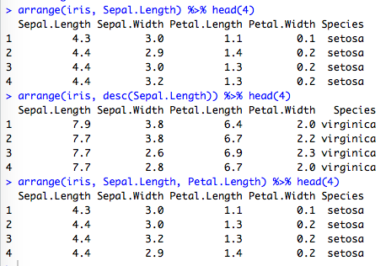
arrange()

Slide 24

ggplot2
Grammar of Graphics
Leland Wilkinson (2005)
Components of a plot
data
aesthetics
attributes of a plot that variables in the data are mapped to
x, y, colour, shape, length, size, linetype
theme

Slide 25
Further Reading
https://r4ds.had.co.nz/

